Slide 1
ABC D
Everyone, Everywhere 2011
Anita Dohn, MD, MSc (Public Health)
Michael Dohn, MD
Matthew St. John (Episcopal Relief &Development)

Slide 2
Structure of Poverty
Poverty
Poor Health
Confounding and “reverse causality”

Slide 3
Competitive Public Space (also called “Contested Public Space”)
NGO’s
Edu’s
Gov’s
CBO’s
FBO’s
“I don’t worry myself about the poor … they have the church to take care of them.
“I don’t worry myself about the rich … they have the government to take care of them.”
~ Facundo Cabral

Slide 4
Community
Spatial
Non-spatial
Social interactions
Shared needs & concerns

Slide 5
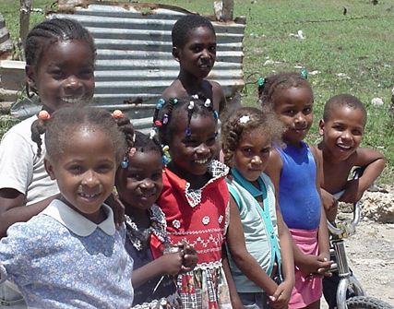
Community Health
What communities can do for themselves

Slide 6
Community Health: Two Premises Mosley WH. Principles of Community Health. In Ewert (ed). A New Agenda for Medical Missions. 1990. Page 39.
First Premise
“The ultimate performance of any health care program is only measurable in terms of improved health among the people.”

Slide 7
Community Health: Two Premises Mosley WH. Principles of Community Health. In Ewert (ed). A New Agenda for Medical Missions. 1990. Page 40.
Second Premise
“Programs must be as concerned about the process of improving health among people as they are about the outcome.”
Notes:
In other words, are our health programs helping individuals, families, and communities to grow in initiative, autonomy and self-reliance –
To grow into their full stature in Christ, if you will.

Slide 8
Assets, Deficits & Needs
Needs
Assets
Deficits

Slide 9
Community Asset Mapping: Building Blocks
Primary
Potential
Secondary
In community, community control
In community, outside control
Outside community, outside control

Slide 10
McKnight J (1995) The careless society: community and its counterfeits. New York: Basic Books. Kretzmann J, McKnight J (1993) Building communities from the inside out: a path towards building and mobilising communities’ assets. Evanston, IL: Institute for Policy Research.

Slide 11
http://www.docstoc.com/ docs/28622740/ 2-Community-Asset-Map-sample

Slide 12
http://www.thedirt.org/node/4954

Slide 13
http://found-money.info/missing-money/state- assets-used-to-secure-hospital-funds/

Slide 14
http://www.flickr.com/ photos/campuskitchens/ 5630808541/

Slide 15
Needs Assessment
Normative
Comparative
Felt
Expressed

Slide 16
How strict an ABCD rule?
Whether, when, and how to apply outside resources

Slide 17
The ‘Quick & Dirty’ Method

Slide 18
The “Outsider” What’s the non-community asset-based developer to do?
Community
Outside ‘experts’
Government
Three-way partnership
Taylor-Ide & Taylor,
Just and lasting change, 2002

Slide 19
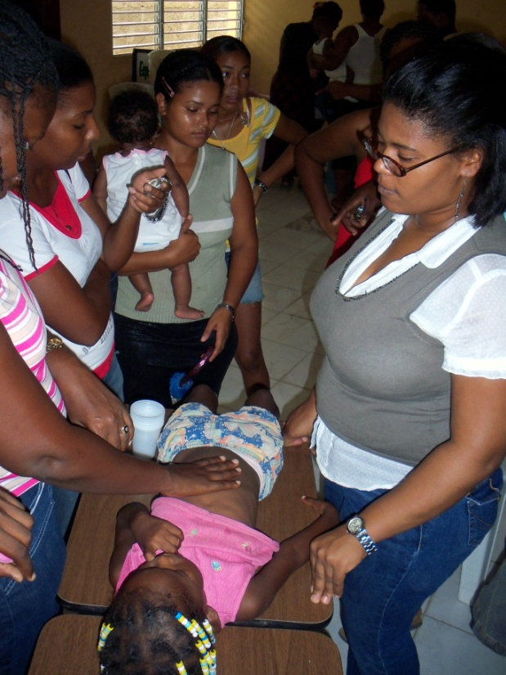
Political & Macro-economic
Socio-economic
Beliefs & Behaviors
Biology
Health Determinants

Slide 20
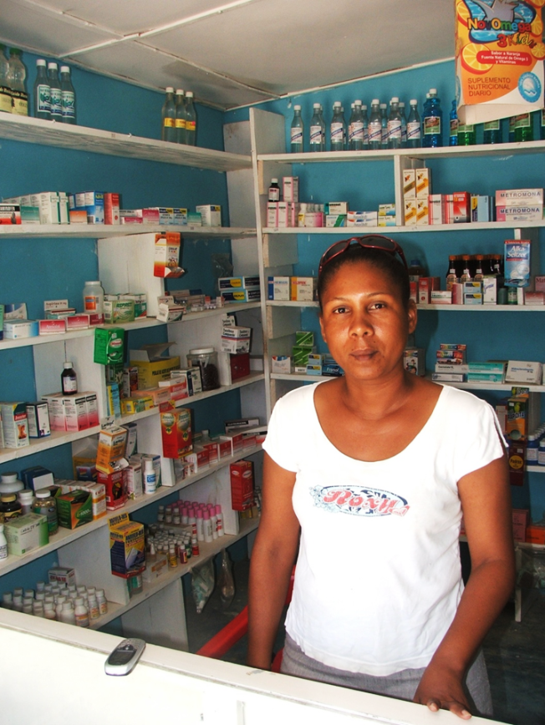
International
Society
Community
National
Individual
Household
Health Determinants

Slide 21
Whose job is it, anyway?
“… responsibilty to address the [upstream] determinants of health rests with the whole government …”
WHO. Bangkok Charter. 2005. Geneva: World Health Organization.

Slide 22
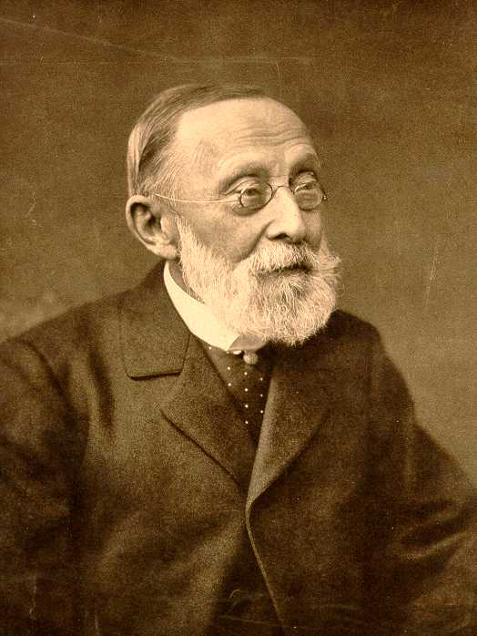
Social Determinants of Health
Communities with high “social capital” are healthier
Speller 2006. In: Health Promotion Theory. Pp 108-24.
Rudolf
Virchow
“…look for where the bodies are piled highest.”

Slide 23
Community Approach
Strengths
Challenges
Effective uptake
‘Value added’ effect
Sustainability
Promotes health equity
Labor intensive
Difficult to scale-up
Highlights conflicts
Marginalized groups
Difficult to evaluate

Slide 24
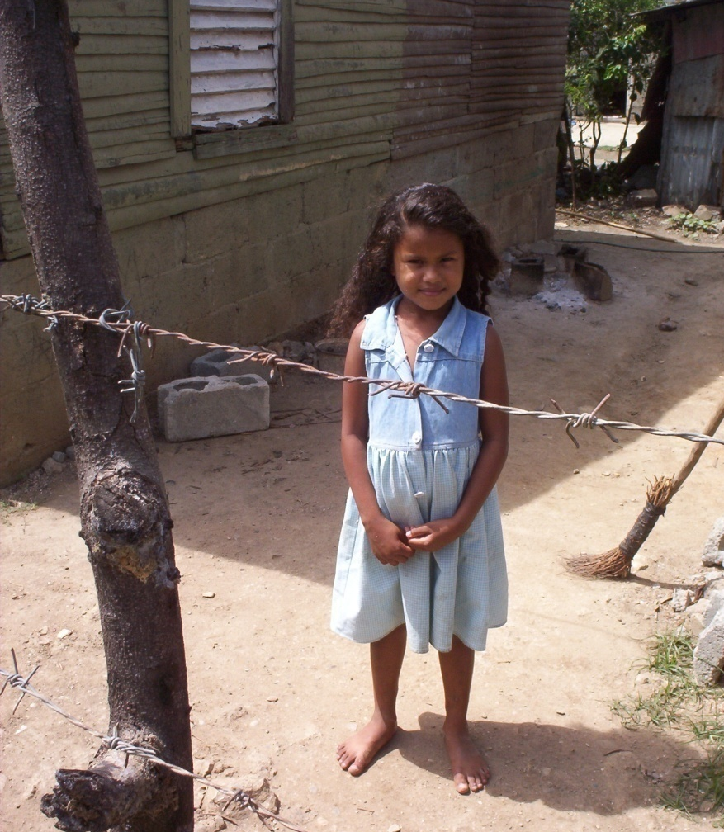
Equity
“Equity is the central challenge for the future of medicine and public health.”
Paul. Farmer. Pathologies of Power. University of California Press. 2005. Page 20.

Slide 25
Evaluation
“Community programs are notoriously difficult to evaluate since they are highly flexible and have complex, often changing goals.”
Hargreaves & Twine. Health promotion practice. 2006.

Slide 26
“Blueprint” versus “Process” Projects
Goal
Intervention
Intervention
Intervention
GOAL
Objective 1
Intervention
Intervention
Objective 2
Intervention
Intervention
Objective 3
Intervention
Intervention
Personnel
Budget
Salaries
Etc.
Program
Budget
Materials
Etc.
Support
Budget
Transportation
Etc.
Initial Plan
Process
Goal

Slide 27
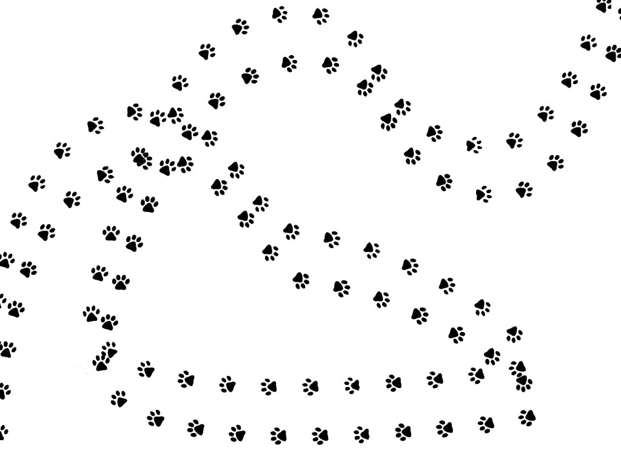
We
Pause …

Slide 28
ABC D
Everyone, Everywhere 2011
Anita Dohn, MD, MSc (Public Health)
Michael Dohn, MD
Matthew St. John (Episcopal Relief &Development)

